Slide 1
DOCUMENTATION SQL PROJECT
V.ASWIN RAJ

Slide 2
Introduction
SQL (Structured Query Language) is a standard language used to manage and manipulate relational databases. It allows users to create, read, update, and delete data efficiently.
Key Features of SQL
Data Querying – Retrieve data using SELECT with filtering, sorting, and grouping.
Data Manipulation – Insert (INSERT), update (UPDATE), and delete (DELETE) records.
Data Definition – Create, alter, and drop tables (CREATE, ALTER, DROP).
Joins & Relationships – Combine data from multiple tables (INNER JOIN, LEFT JOIN, etc.).
Aggregation – Perform calculations like SUM, COUNT, AVG for summaries.
Transactions – Ensure data integrity with COMMIT, ROLLBACK, and ACID properties.
Indexing – Improve query speed by creating indexes on columns.
Security & Access Control – Manage permissions (GRANT, REVOKE) for user roles.

Slide 3
History of SQL
Developed in the 1970s by IBM researchers Donald D. Chamberlin and Raymond F. Boyce.
Initially called SEQUEL (Structured English Query Language).
Standardized by ANSI in 1986 and ISO in 1987.
Over time, different versions and optimizations were introduced by database vendors.

Slide 4
SQL Statements
DML-Data Manipulation Language
DQL –Data Query language
DCL –Data Control Language
TCL-Transaction Control Language

Slide 5
Most Used Databases
MySQL
Open-source, widely used for web applications
PostgreSQL
Advanced open-source database with powerful features
Microsoft SQL Server
Developed by Microsoft, popular in businesses.
Oracle Database
Enterprise-level, known for performance and security

Slide 6
Data Types in SQL
– INT, FLOAT, DECIMAL
Character – CHAR, VARCHAR, TEXT
Date & Time – DATE, TIME, DATETIME
Boolean – TRUE/FALSE
Binary Data – BLOB
Numeric

Slide 7
LOAN MANAGEMENT PROJECT

Slide 8
The Loan Management System analyzes customer income, loan status, and regional data for loan eligibility and risk assessment
customer income analysis: categorizes income levels and calculates monthly & annual interest.
loan status & cibil score: implements triggers to update loan processing and risk categories.
customer info update: modifies gender and age details based on customer id.
geographical data integration: merges country, state, and region details.
unified data output: joins five tables to generate a consolidated dataset.
mismatch detection: identifies inconsistencies in data joins.
data filtering: extracts high cibil scores and customer types via inner joins.
stored procedures: saves filtered outputs for efficient retrieval and reporting.

Slide 9
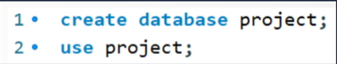

Creating Database Creating database as “project” to use the database and after set the auto commit to ‘off’ to perform rollback and then start the transaction.

Slide 10
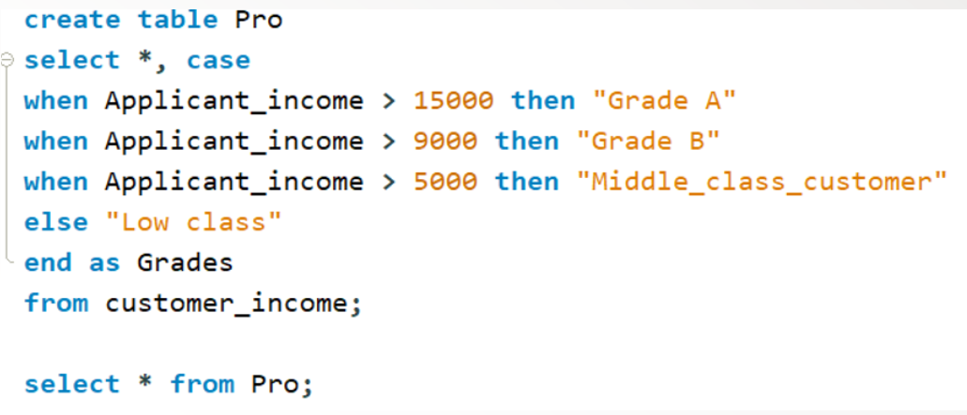
Code to Set Criteria:

Slide 11
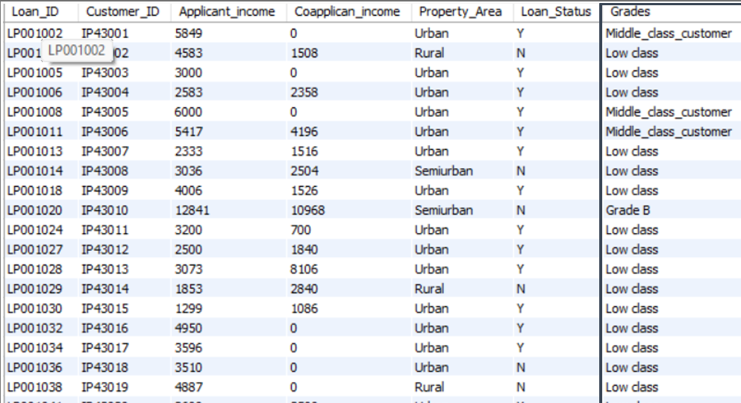
Table 1 – pro

Slide 12
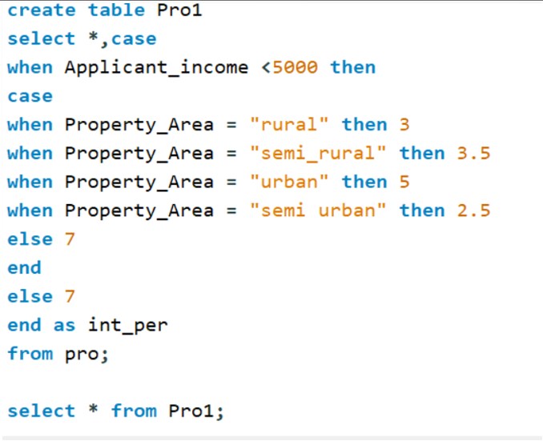

Slide 13
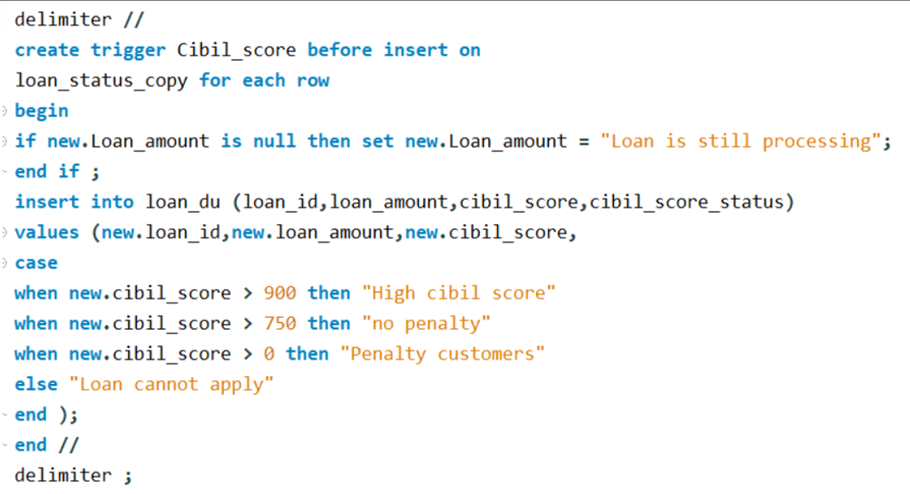
Creating Row level Trigger and Statement Level Trigger

Slide 14
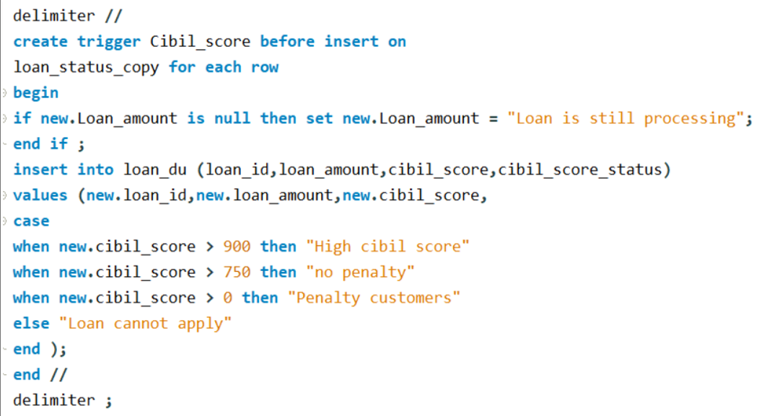
Creating Row level Trigger and Statement Level Trigger

Slide 15
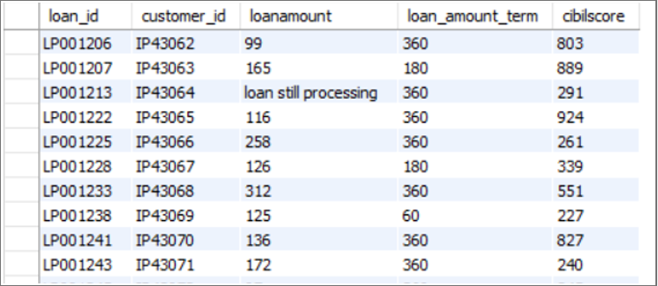
Loan Still Processing Customers

Slide 16
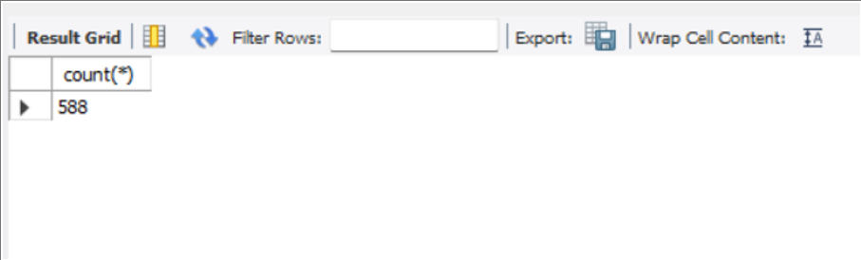
Deleting the customers who’s application and loan amount are not processed
After Deleting the Customers the total number of Customers are

Slide 17
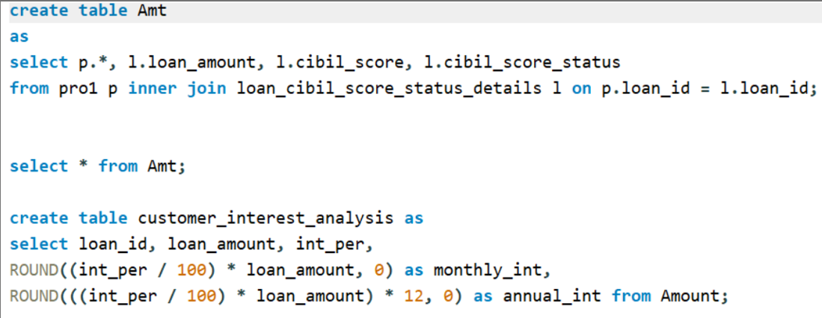
Annual and Monthly Interest Calculation

Slide 18
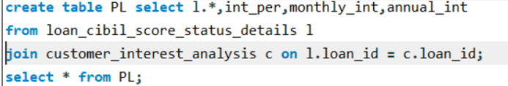
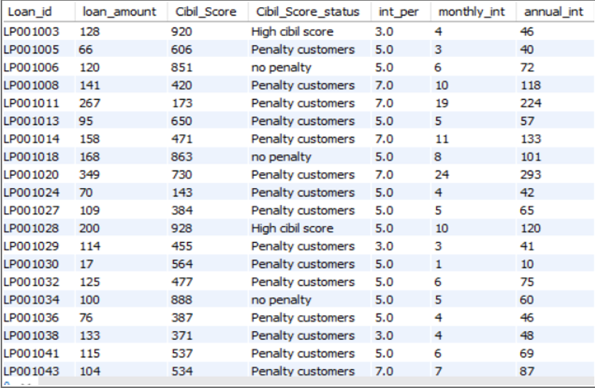
Join tables
Out put

Slide 19
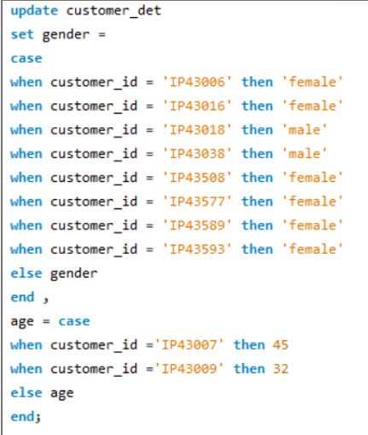
Updating the Gender and age of customers

Slide 20
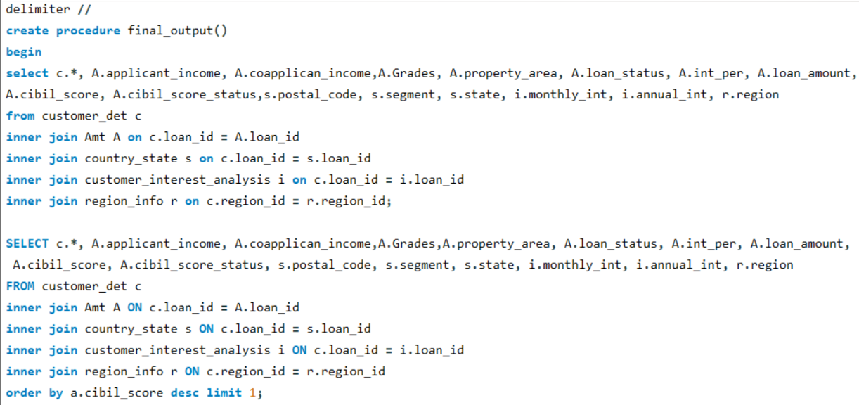
Create a procedure called final_output that includes all join queries.

Slide 21
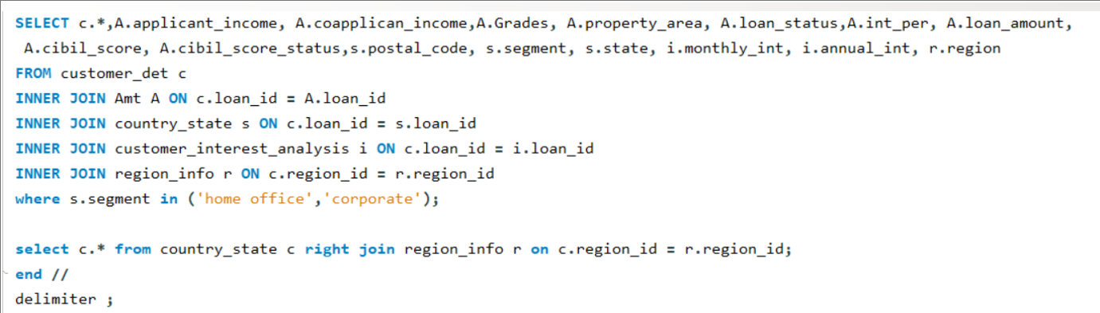
Ending the procedure using delimiter

Slide 22
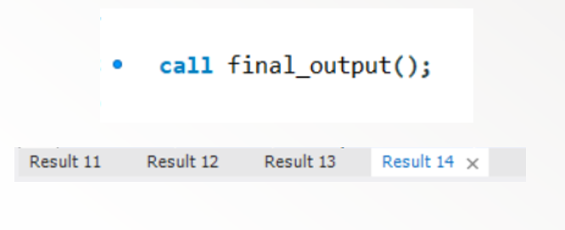
Calling procedure for all output

Slide 23
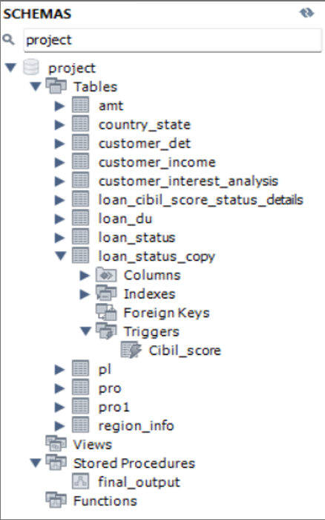
Schema

Slide 24
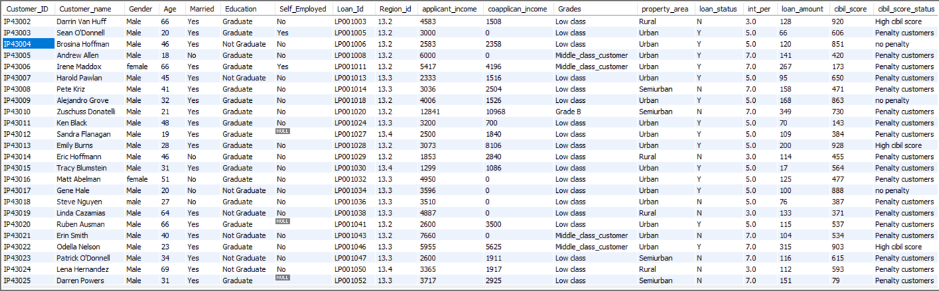
Output 1

Slide 25
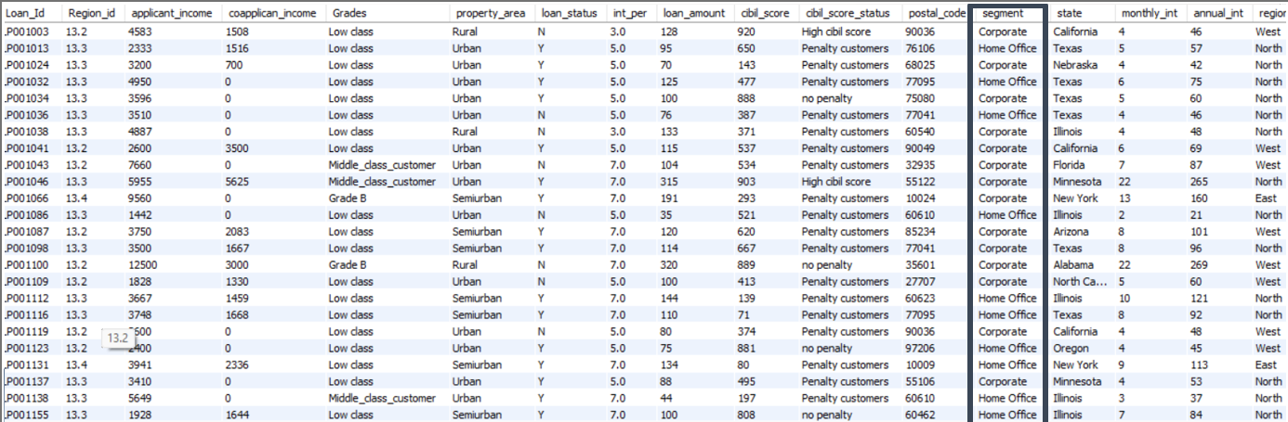
Output 2
Output Output 3
3
Output 3

Slide 26
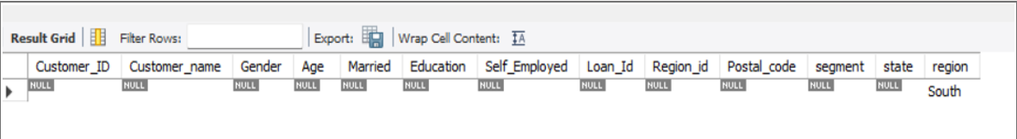
Out put 4

Slide 27
Thankyou

